Slide 1
Electrical Readout of NVˉ Centers in Diamond
Felix Hartz
Master Talk
9/19/2017
Notes:
Grundstruktur:
Einführung: NV- ist toll
NV Zentrum Levelschema
ESR, optisch detektiert (ODMR), erkläre im Levelschema, dann zeige ODMR Setup. Am Ende der Folie sage ich, dass ODMR aufwändig ist (Filter, APD, Lange Wartezeiten (bei kleiner Countrate, Effizienz, …)
Deshalb: elektrisch von Vorteil: pEDMR (viel zeit lassen, ausführlich Dynamik diskutieren
(leider kleiner Strom, muss verstärkt werden, was das ganze Detektionsverfahren langsam macht)
Darauf basierend erkläre ich meine Stromauslese endlich, indem ich das zweite Setupbild zeige.
Danach MSM Detektor

Slide 2
Outline
Motivation
Theory
NVˉ Spectrometer
Spin-to-Charge Conversion
Summary and Outlook
9/19/2017
Felix Hartz
2
Notes:
Theory of Physical principles we use for readout of NV
Introduce new spectrometer, show spin resonance experiments
Discuss the level diagram of nv- and how this knowledge can be used for improvement of spin to charge conversion
BEFORE I come to the conclusions and an outlook

Slide 3
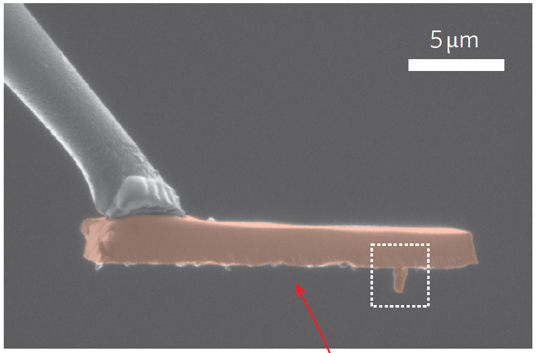
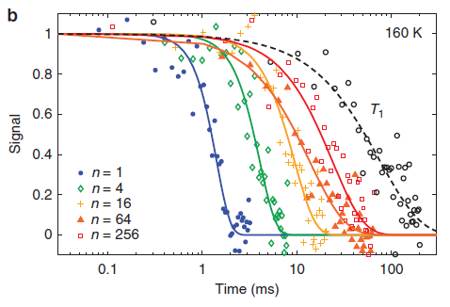
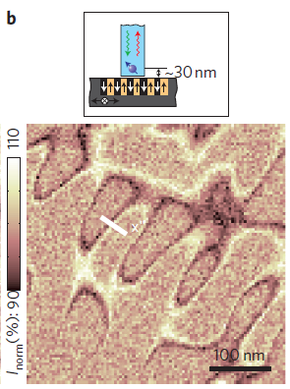
Motivation
single NV⁻ center magnetometer
long spin coherence time
signal (normalized)
time (ms)
N. Bar-Gill, Nature Communications 4,1743 (2013)
Maletinsky et al., Nature Nanotechnology 7 (2012)
9/19/2017
Felix Hartz
3
Notes:
Diamond nanopillar with single NV: scan hard disk magnetic field domains
Spin coherence can be enhanced by applying a pulse sequence multiple times

Slide 4
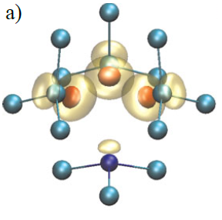
NVˉ Center in Diamond
V
N
C
microwave photons
E_{photon}=ħf
m_{s}
+1
Hamiltonian for spin system
E
^
H=μ_{b}gSB₀ + SDS
D
0
Gali et al., Phys. Status Solidi B 248, 1337 (2011)
-1
Christle, Nature Materials 14, 160 (2015)
B₀
9/19/2017
Felix Hartz
4

Slide 5
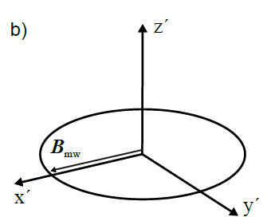
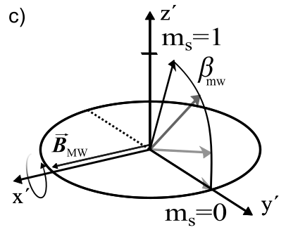
Coherent Spin Control
rotating frame system
nutation of spin vector S
S
spin vector
B_{MW}
B_{MW}
S
Hamiltonian
^
H=μ_{b}gSB_{MW} + SDS
D → frequency of B_{MW}
nutaion frequency
ħω_{nut} =gμ_{b}Β_{MW}
ω_{nut} → amplitude of B_{MW}
M. H. Levitt: Spin Dynamics (Wiley, 2001)
Christle, Nature Materials 14, 160 (2015)
9/19/2017
Felix Hartz
5

Slide 6
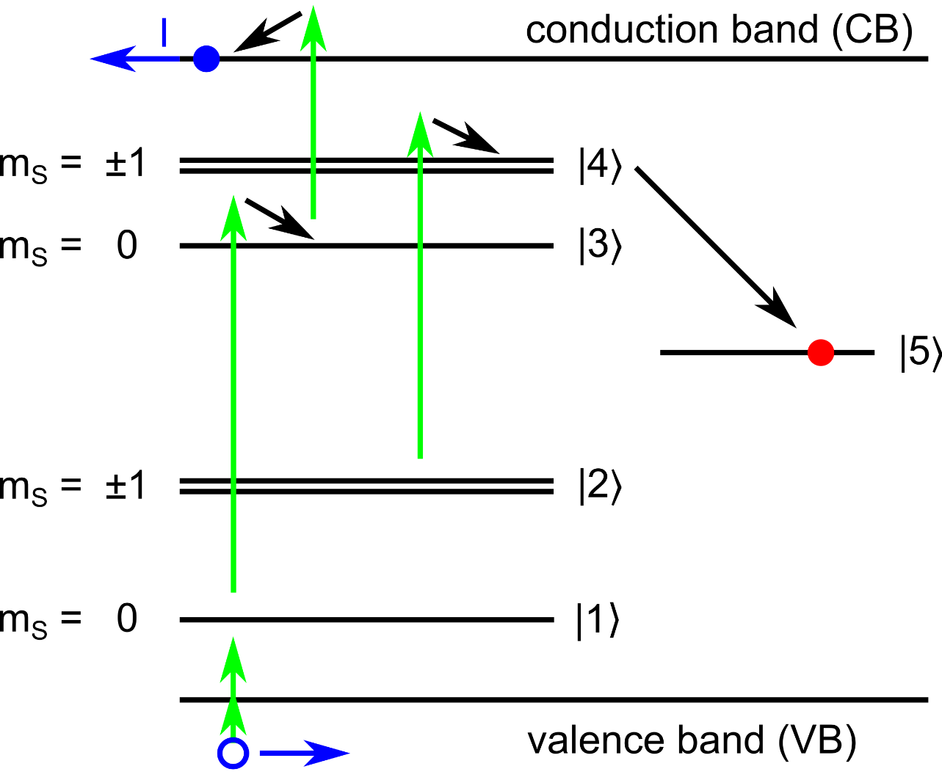
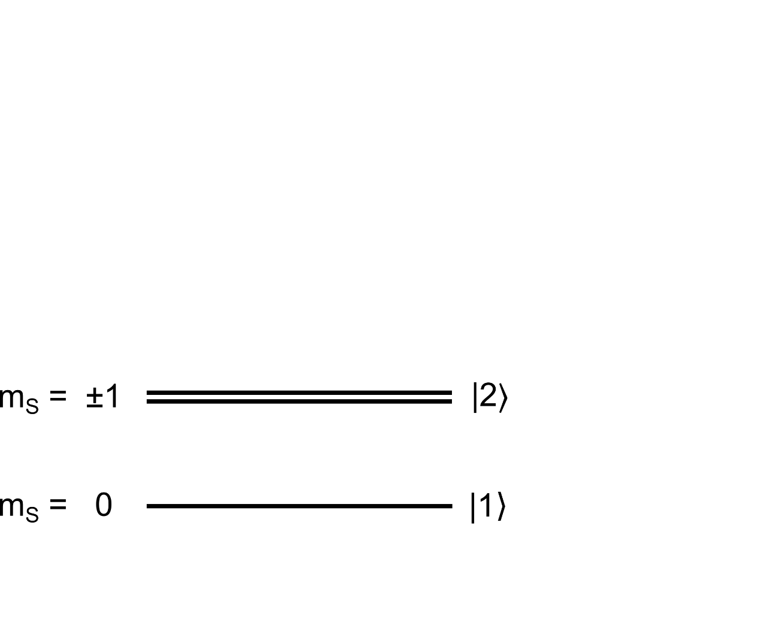
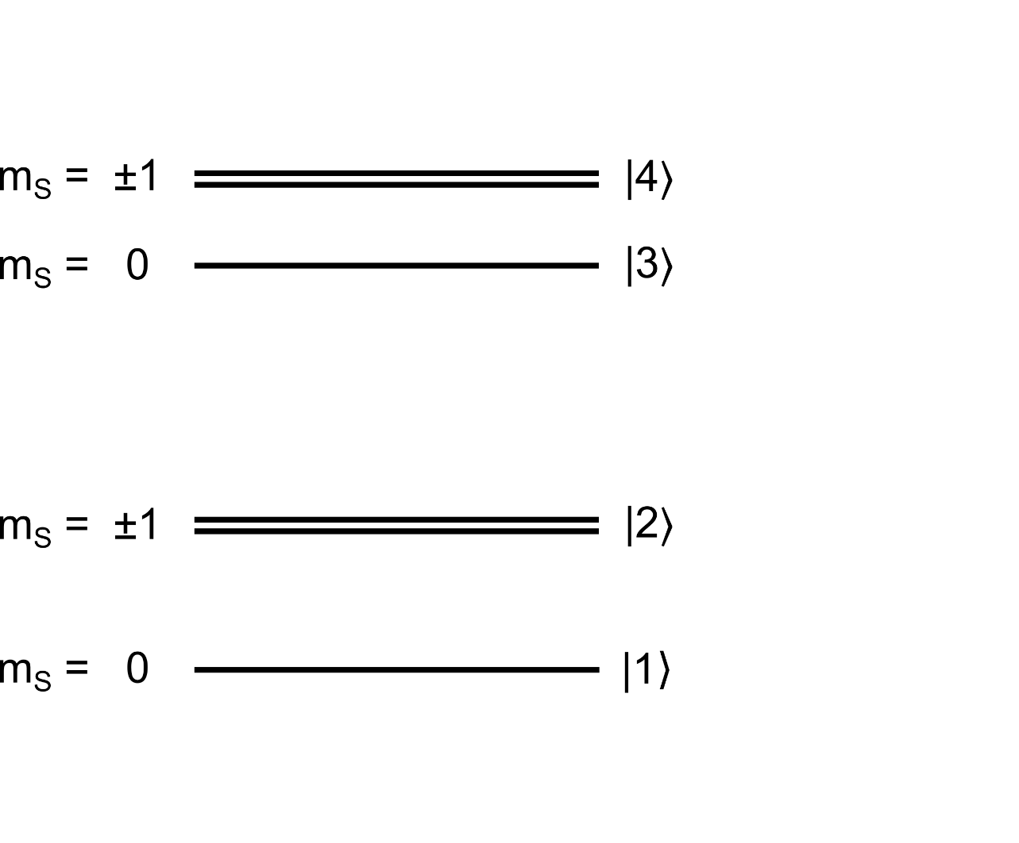
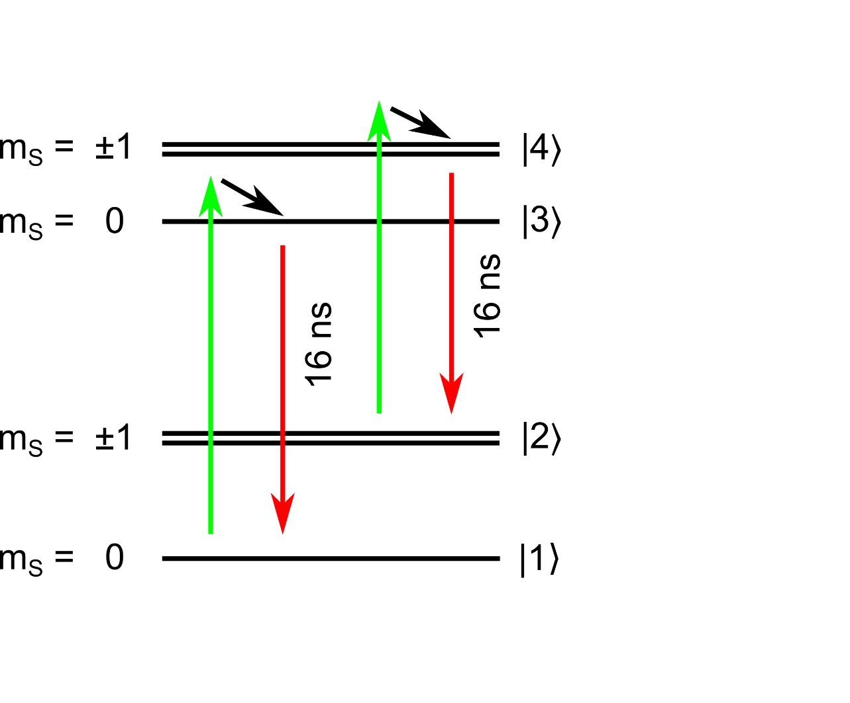
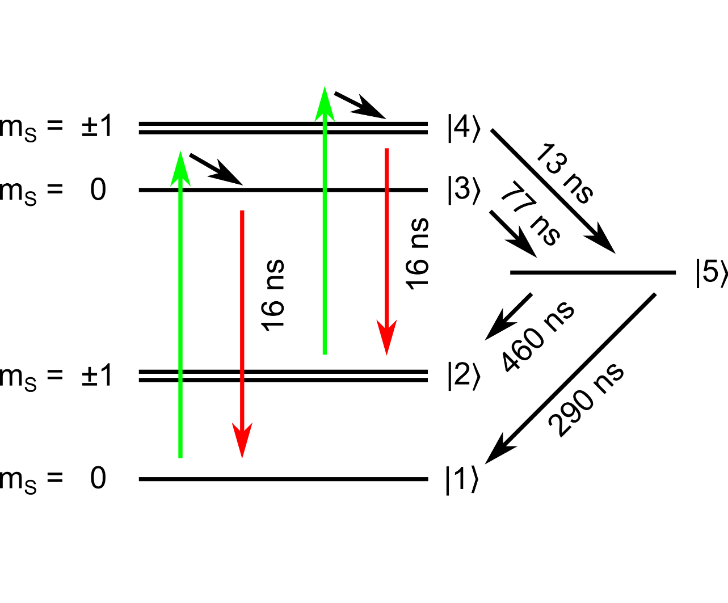
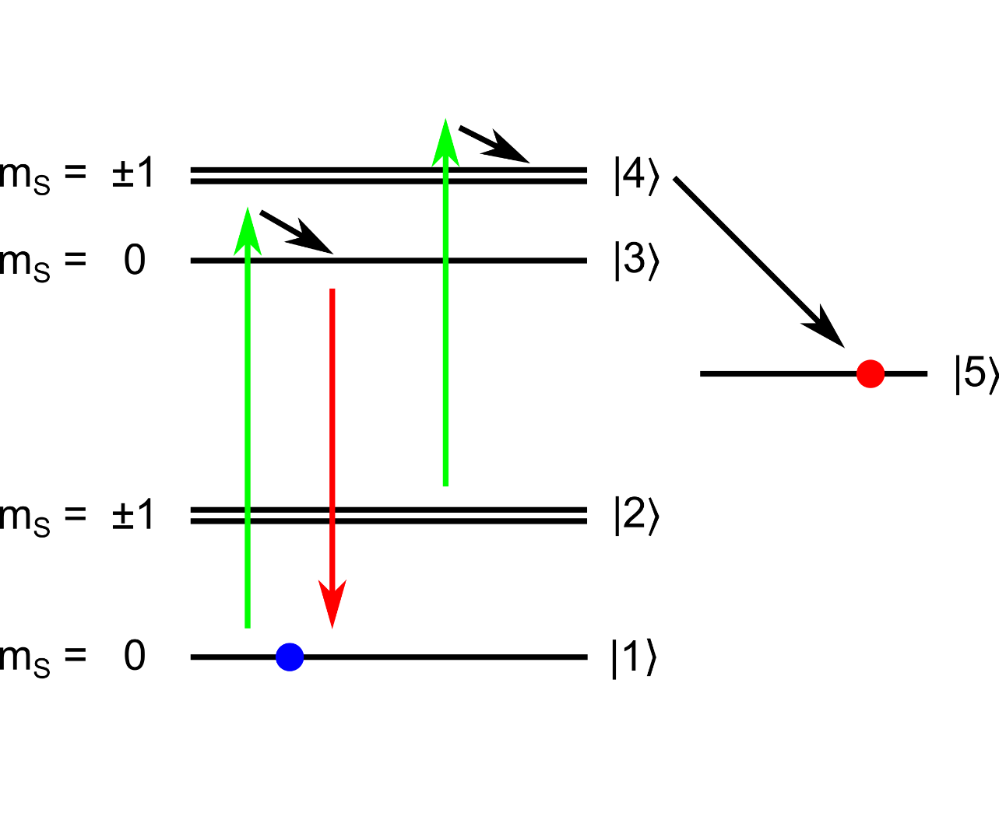
NVˉ Level Diagram
dark state
Robledo, NJP 13, 025013 (2011)
9/19/2017
Felix Hartz
Notes:
Opt ground state triplet
Opt excited, spin conserving optical transitions
(CYCLING) for ms = 0
Schelfing into dark state for ms 1
For ms=0: ionization out of excited NV-

Slide 7
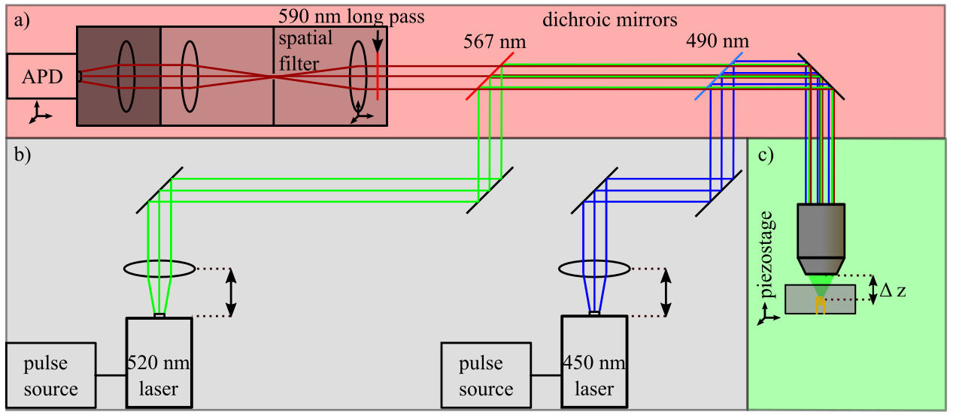
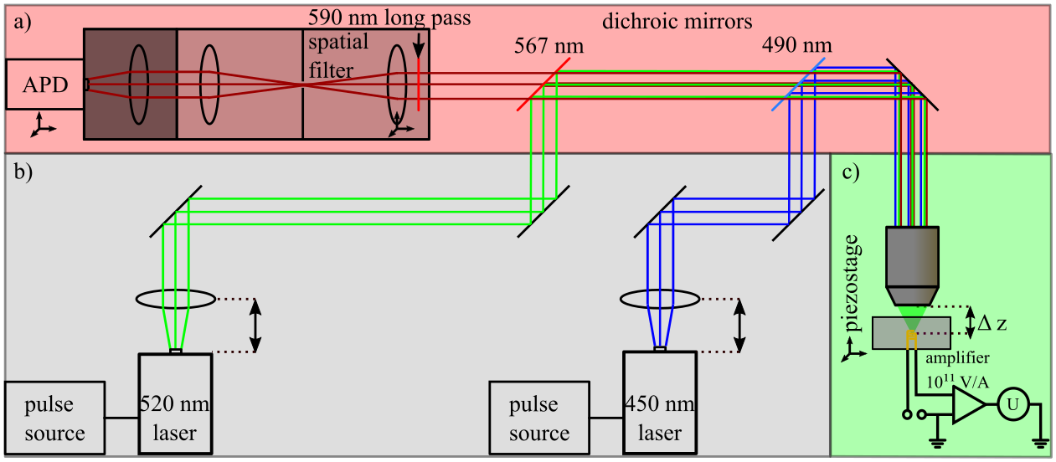
Optical Readout
Electrical Readout
U
U_{b}
9/19/2017
Felix Hartz
7

Slide 8
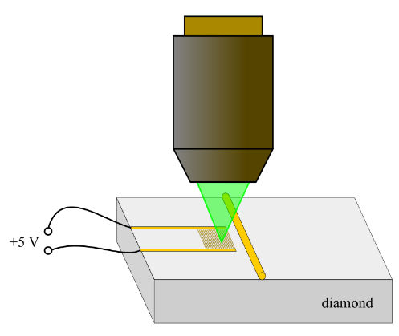
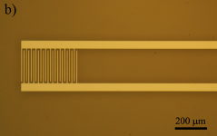
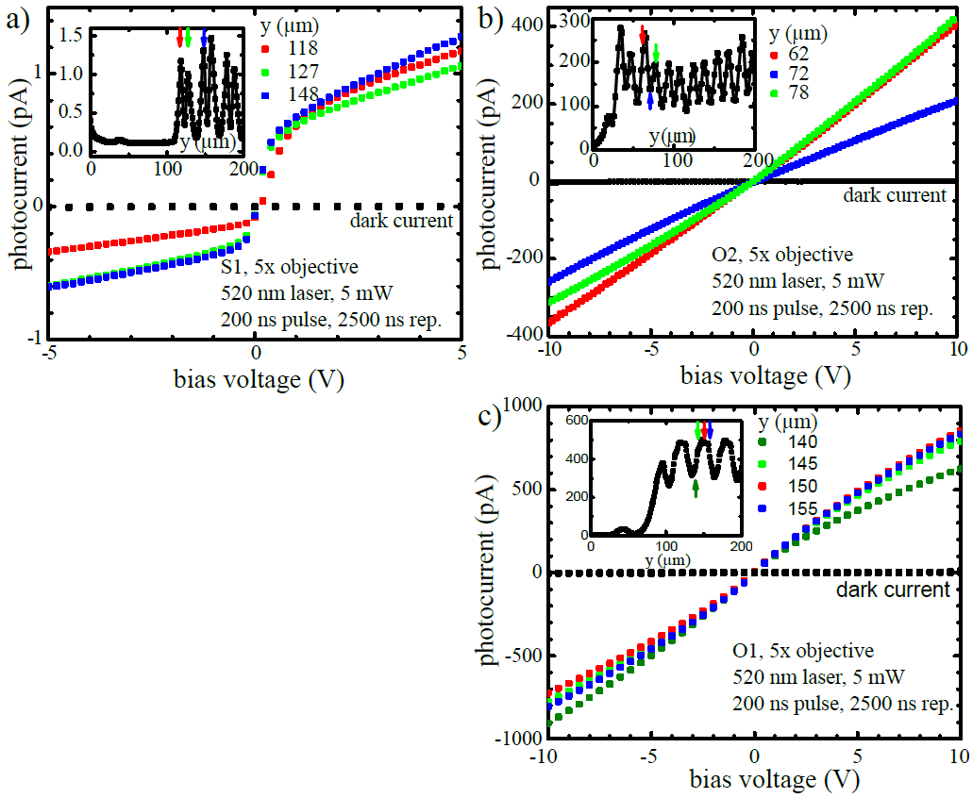
High Purity Diamond Sample
bias voltage
U_{b}
type IIa diamond, [N] < 1 ppm
interdigital contacts, 10 μm gap
oxygenated surface with
Ti/Au metallization: Schottky barrier
200 μm
microscope image
back-to-back diode
9/19/2017
Felix Hartz
8

Slide 9
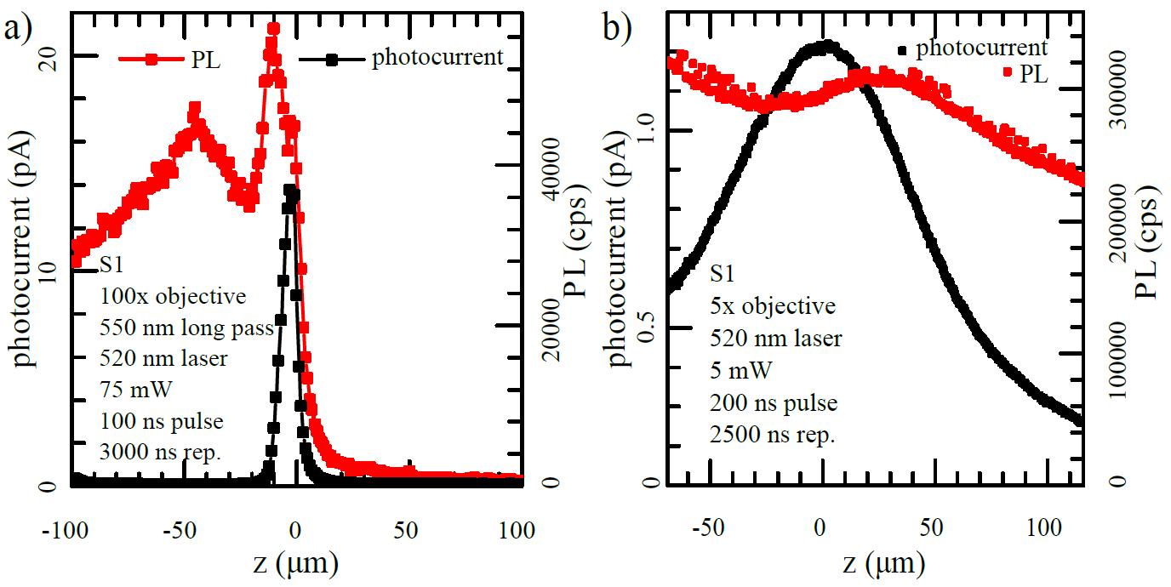
Photocurrent Detection: Depth Dependence
high resolution
100x objective
homogeneous illumination
5x objective
z
x
y
9/19/2017
Felix Hartz
9

Slide 10
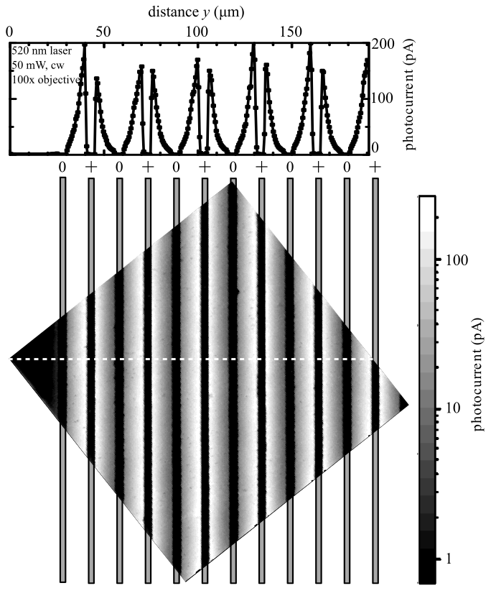
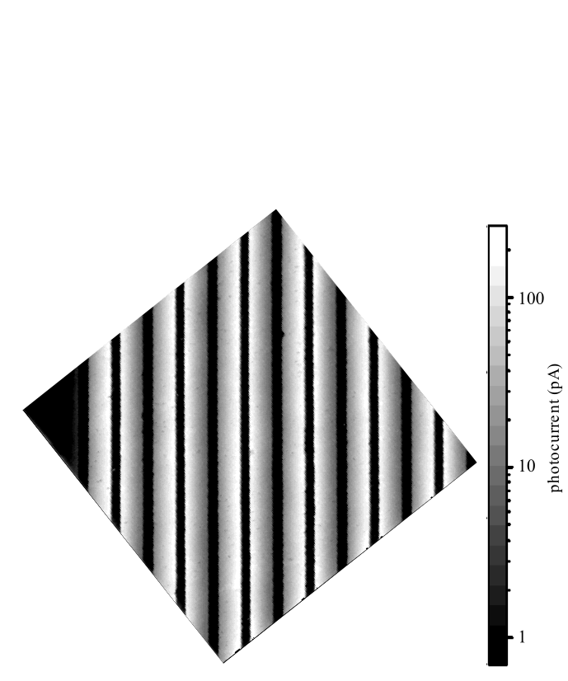
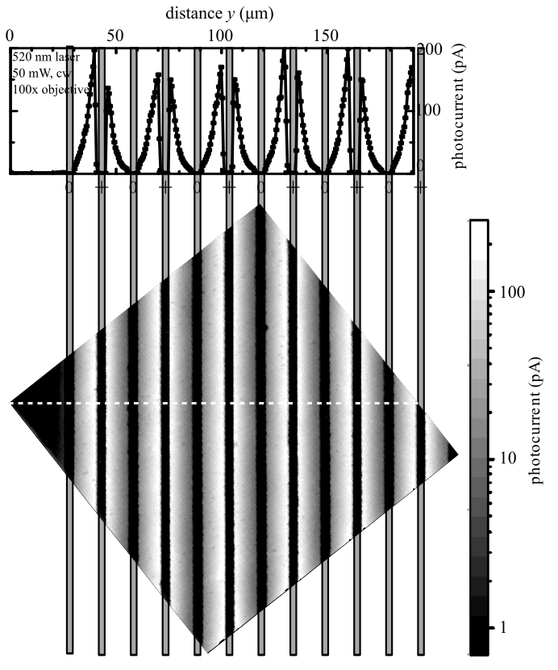
Photocurrent Detection: Lateral Dependence
photocurrent (pA)
metal contacts
z
x
y
photocurrent (pA)
9/19/2017
Felix Hartz
10

Slide 11
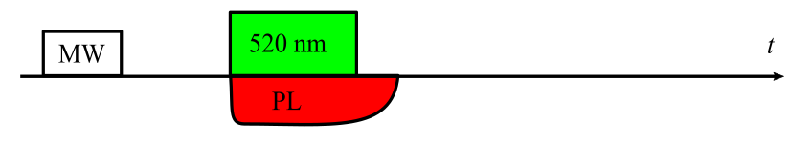
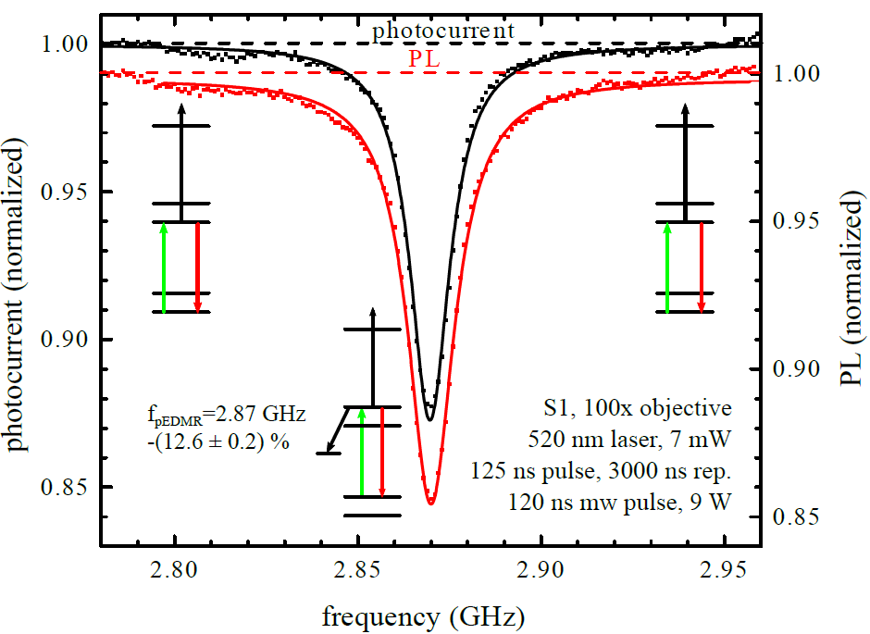
Electrical versus Optical Readout
bias voltage
U_{b}
frequency f
readout method | optical | electrical
res. frequency (MHz) | 2870.04 ± 0.04 | 2870.14 ± 0.07
linewidth (MHz) | 14.90 ± 0.15 | 13.3 ± 0.13
spin-contrast (%) | -(14.4 ± 0.2) | -(12.6 ± 0.2)
room temperature
9/19/2017
Felix Hartz
11
Notes:
1 Pulse sequence: mw pulse initializes NV spin, green laser excitation and ionization of NV-
When spin prepared to ms1, shelfing into dark state
2 table: the same resonance frequency within the small error bars (40-70 kHz)
(df/f=70 000 für pEDMR, 40000 for ODMR)
linewidth smaller in pEDMR: different excitation volume, linewidth narrowed under higher excitation power
Contrast comparable, function of the laser intensity and duration

Slide 12
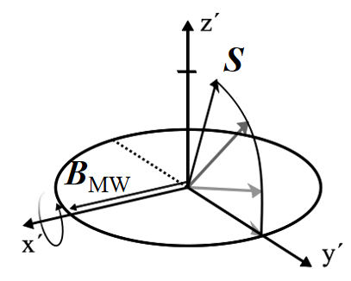
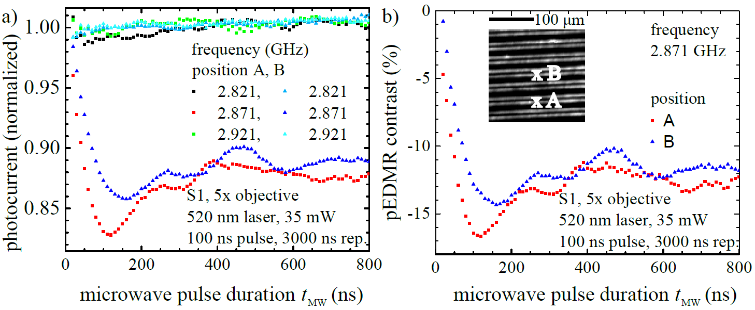
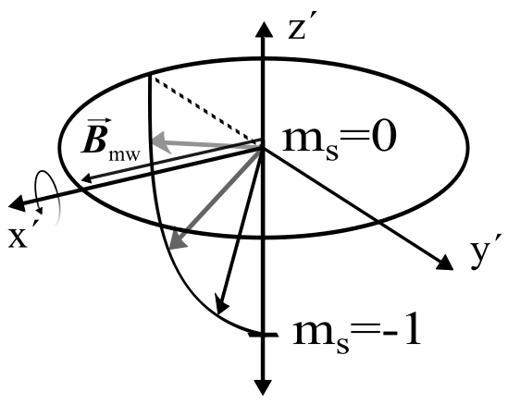
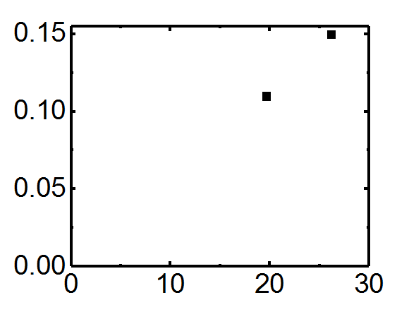
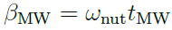
Coherent Control
microwave
pulse duration
bias voltage
U_{b}
B_{MW} (mT)
MW wire
ω_{nut} (mT)
9/19/2017
Felix Hartz
12
Notes:
1 Flat off res data, in resonance spin transitions induced, depending on t_{MW.}
2 t_{min} varies with distance.
When t is used to derive B that is assumed to decrease with 1/R
assuming R1=180 and R2 / 240 (R0=180, Feld dort 0.15 mT), tpi=120 ns

Slide 13
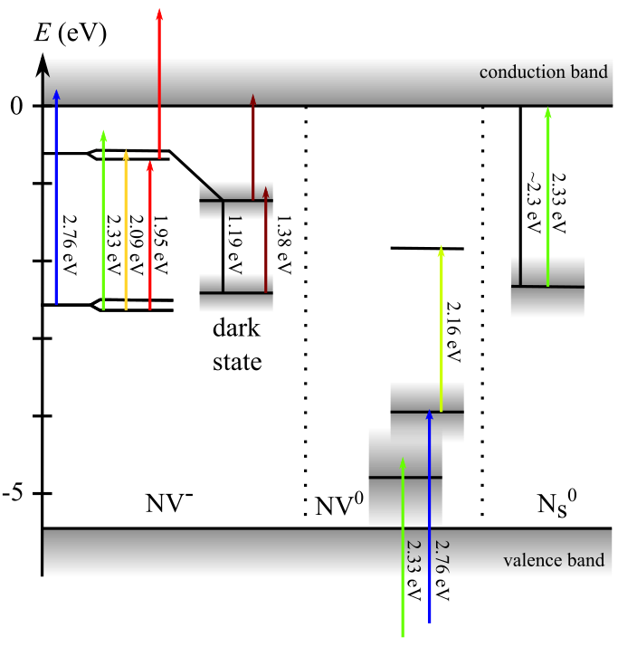
Spin-to-Charge Conversion (SCC)
Measurement and Control of Single Nitrogen-Vacancy Center Spins above 600 K
D. M. Toyli, D. J. Christle, A. Alkauskas, B. B. Buckley, C. G. Van de Walle, and D. D. Awschalom
Phys. Rev. X 2, 031001 – Published 5 July 2012
Dark state excited state \5> : ~0.8 eV unter \3>,\4>
Bourgeois, PRB 95, 041402(R) (2017)
Chen, PRB 92, 104301 (2015)
Chen, PR Appl. 7, 014008 (2017)
Hopper, PRB 94, 241201(R) (2016)
Nesladek, APL, 72, 3306, (1998)
Schields, PRL 114, 136402 (2015)
9/19/2017
Felix Hartz
13
Notes:
To scale, bandgap -5.45 eV, arrows to scale
NV- shaded area: uncertainty of the energy level
NV0
Ns0 substitutional, neutral charge state, can be ionized

Slide 14
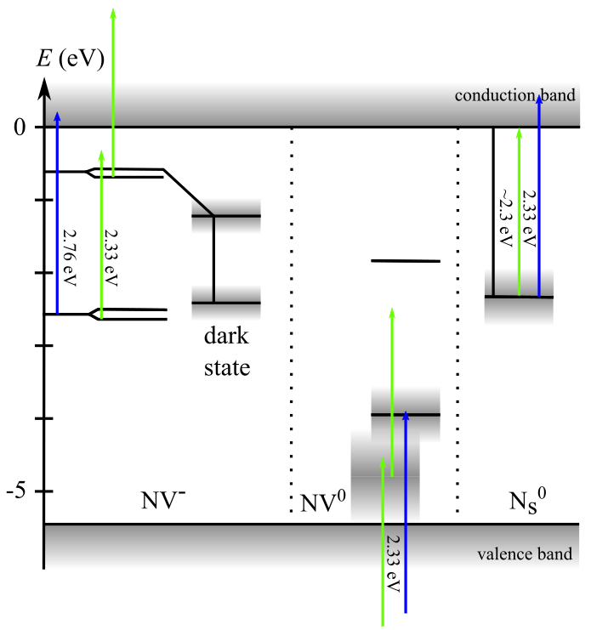
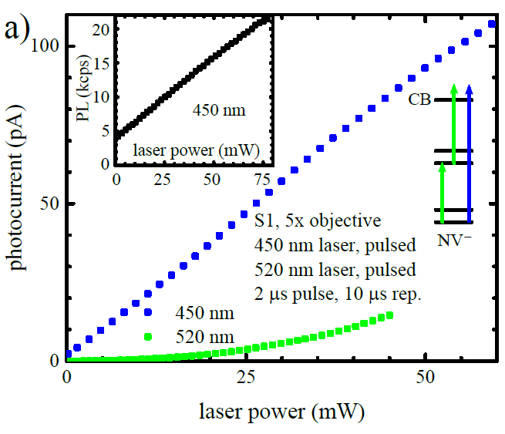
Linear Photoionization of NVˉ
+5 V
9/19/2017
Felix Hartz
14

Slide 15
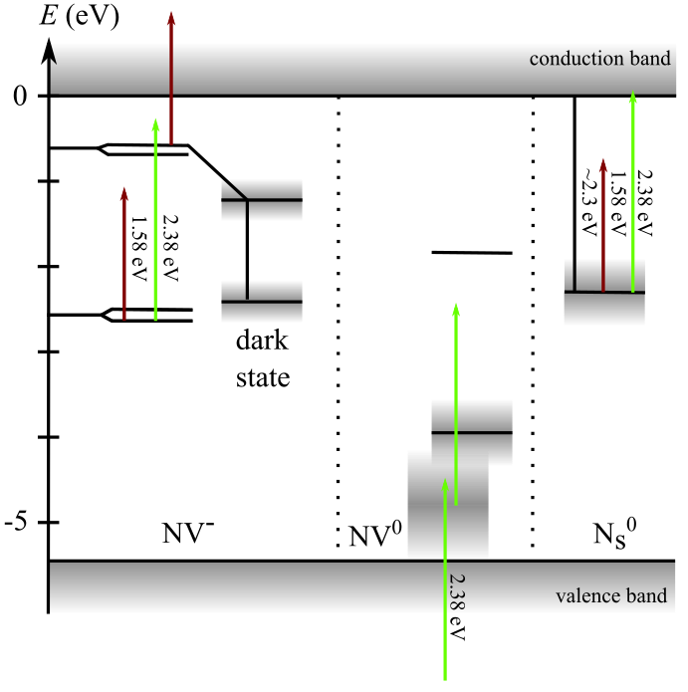
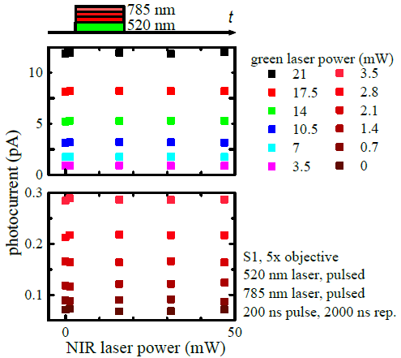
NIR Laser
green laser
power
9/19/2017
Felix Hartz
15

Slide 16
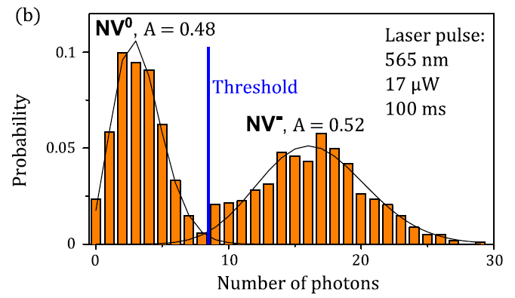
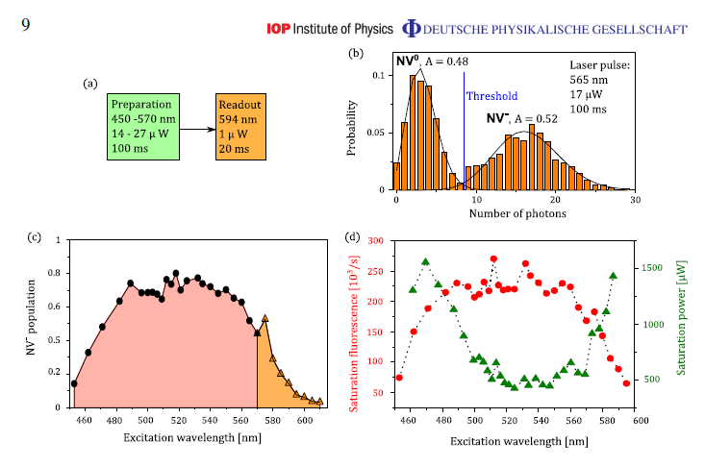
Spin-independent Charge-Conversion Efficiency
non-destructuve detection of the charge state
dominant charge state
NV⁰
NVˉ
NV⁰
N. Aslam, New Journal of Physics 15, 013064 (2013)
9/19/2017
Felix Hartz
16

Slide 17
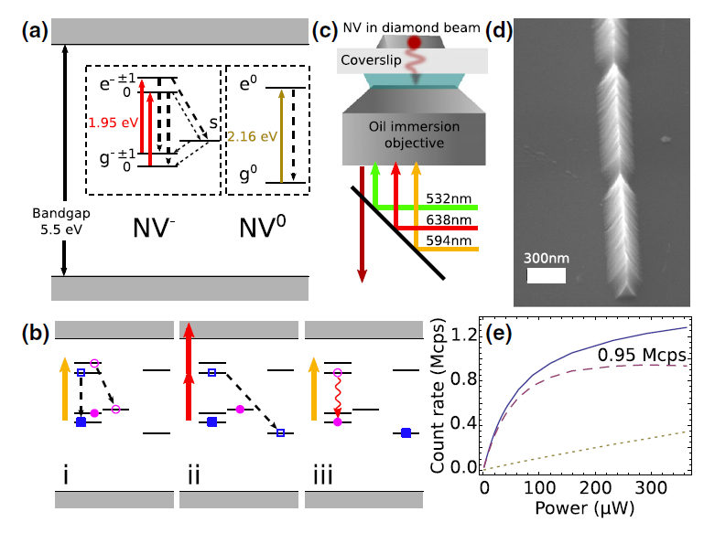
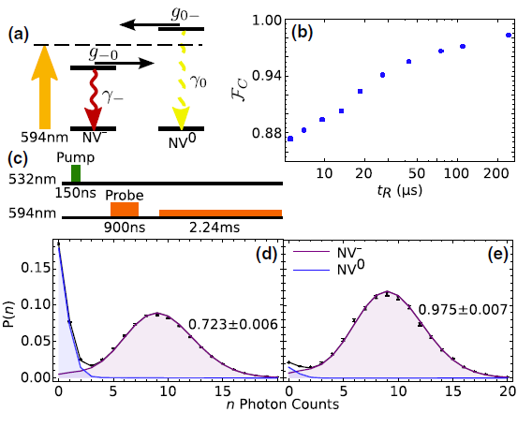
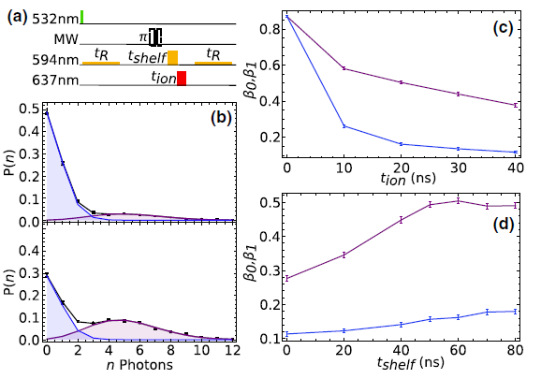
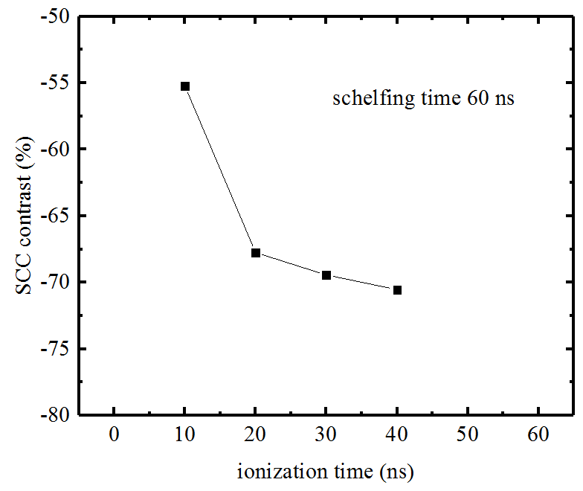
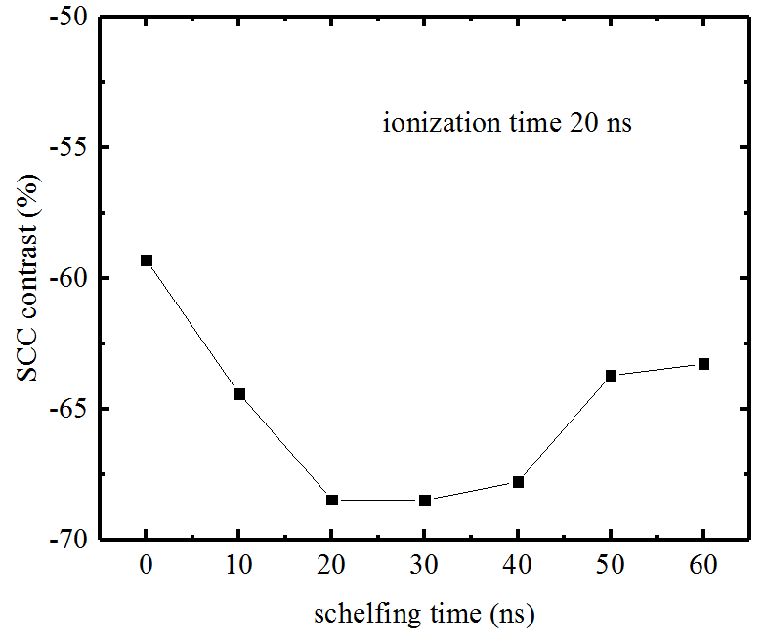
Spin-to-Charge Conversion: Schields
t_{shelf} = 60 ns
m_{s} = 1
SCC contrast (%)
NV⁰
m_{s} = 0
m_{s} = 0
NVˉ
t_{ion} (ns)
m_{s} = 1
t_{ion} = 20 ns
NV⁰
m_{s} = 1
SCC contrast (%)
NVˉ
m_{s} = 0
t_{shelf} (ns)
Schields, PRL 114, 136402 (2015)
9/19/2017
Felix Hartz
17

Slide 18
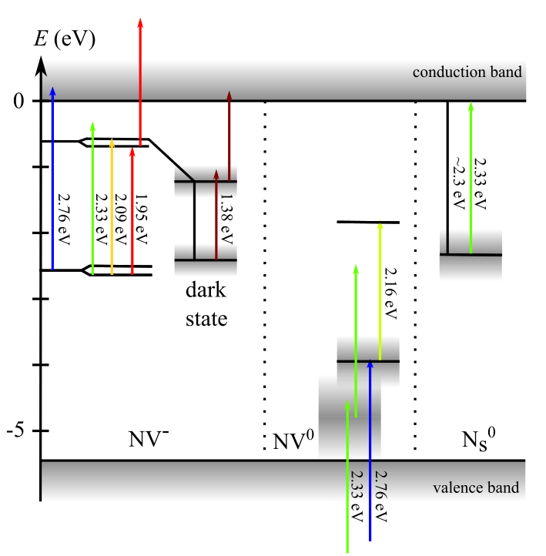
Summary
demonstration of SCC at the new NVˉ spectrometer (electrical and optical)
first studies on dual-laser excitation SCC
verification and concretisation of NVˉ level diagram
9/19/2017
Felix Hartz
18

Slide 19
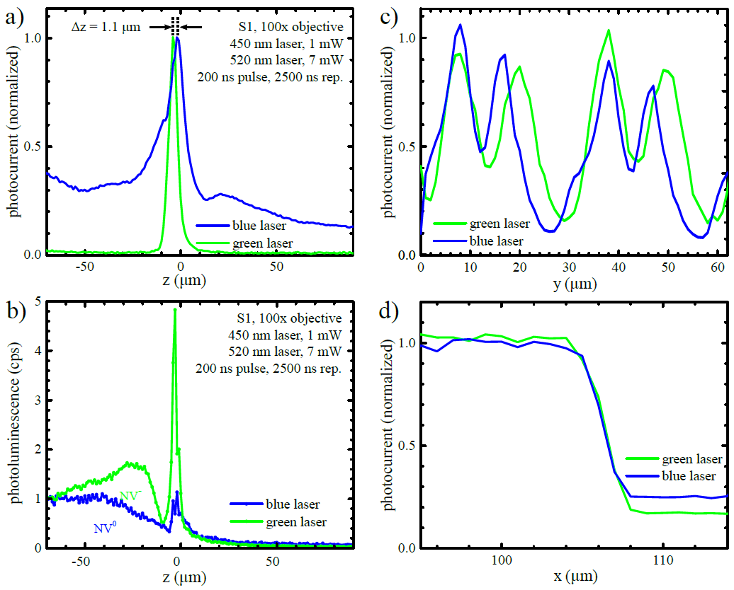
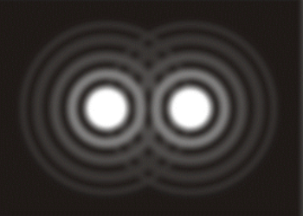
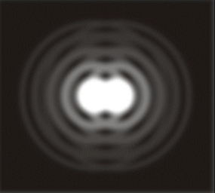
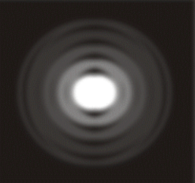
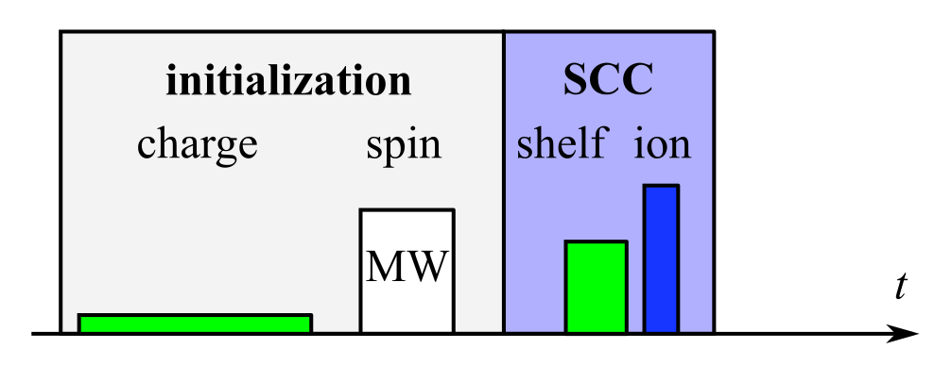
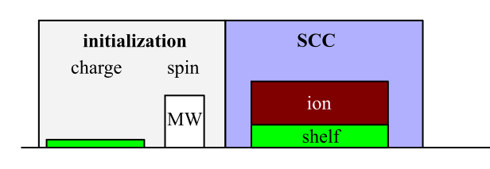
Outlook: Multi-Laser Pulse Sequences for SCC
feedback: 1 dimensional
2 dimensional
photocurrent / photoluminescence
reflection
optimized pulse sequences
SCC method | optical | electrical
contra | long readout time after each SCC step | photocurrent contribution from N_{s}⁰, slow (transimpedance amplifier / lock-in)
pro | high SCC contrast | no detection optic required, possibly faster (single electron transitor)
9/19/2017
Felix Hartz
19

Slide 20
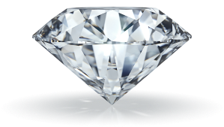
Thank you for your attention.
Special thanks to:
Prof. Martin Brandt
Prof. Martin Stutzmann
Florian Hrubesch
E25 group
9/19/2017
Felix Hartz
20

Slide 21
Spin-to-Charge Conversion (SCC)
Measurement and Control of Single Nitrogen-Vacancy Center Spins above 600 K
D. M. Toyli, D. J. Christle, A. Alkauskas, B. B. Buckley, C. G. Van de Walle, and D. D. Awschalom
Phys. Rev. X 2, 031001 – Published 5 July 2012
Dark state excited state \5> : ~0.8 eV unter \3>,\4>
9/19/2017
Felix Hartz
21

Slide 22
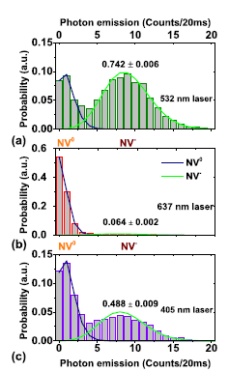
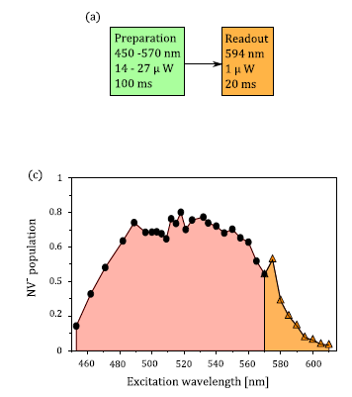

SCC: Charge State Initialization
λ_{init} (nm) | NVˉ propability | data | reference
532 | 75 %, 74.2 % |  | Hrubesch 2017, Chen 2015, PHYSICAL REVIEW B 92, 104301 (2015)
637 | 6% |  | Chen 2015, PHYSICAL REVIEW B 92, 104301 (2015)
405 | 48.8 % |  | Chen 2015, PHYSICAL REVIEW B 92, 104301 (2015)
532 | 72.3 % (97.5 % optimized) |  | Schields, PRL 114, 136402 (2015)
450-610 | 0<p<75% as a function of λ_{init} |  | N. Aslam, New Journal of Physics 15, 013064 (2013)
~900-1000 (spectrum) | 70- 90 % as a function of P_{NIR} |  | Hopper, PHYSICAL REVIEW B 94, 241201(R) (2016)
Felix Hartz
9/19/2017
Felix Hartz
22

Slide 23
method | λ_{init} (nm) | λ_{shelf} (nm) | λ_{ion} (nm) | initial spin polarization | SCC contrast | reference
single laser | 532 520 | 532 520 | 532 (2) 520 (2) | 75 % (fitted value) - | -14 % -13.5 % | Hrubesch Hartz
dual laser | 532 | 532 | 450 (1) |  | -9 % | Gulka, Nesladek
triple laser | 532 | 594 | 638 (2) |  | -70 % | Schlieds
dual /triple | 532 | 637 | 405 |  | -10 % | Chen 2015
triple laser | 532 | 637 | 780 |  | -5 % | Chen 2017
NIR laser assisted | 532 | 532 | 900-1000 spectrum | 85% | -7 % | Hopper 2016
method | λ_{init} (nm) | λ_{shelf} (nm) | λ_{ion} (nm) | initial spin polarization | SCC contrast | reference
Single green laser | 532 520 | 532 520 | 532 (2) 520 (2) | 75 % (fitted value) - | -14 % -13.5 % | Hrubesch Hartz
Dual laser excitation | 532 | 532 | 450 (1) |  | -9 % | Gulka, Nesladek
Triple laser excitation | 532 | 594 | 638 (2) |  | -70 % | Schlieds
 | 450-620 | Recombination and ionization rates 560 vs 590 nm (quadratic both) |  |  |  | Aslam 2013
 | 532 | 637 | 405 |  | -10 % | Chen 2015
 | 532 | 637 | 780 |  | -5 % | Chen 2017
Dual (laser) exciation Or: NIR laser assisted | 532 | 532 | 900-1000 spectrum | 85% | -7 % | Hopper 2016
Overview: SCC Methods
electical readout | λ_{init} (nm) | λ_{shelf} (nm) | λ_{ion} (nm) | initial spin polarization | SCC contrast | reference
single laser | 532 520 | 532 520 | 532 (2) 520 (2) | 75 % (fitted value) - | -14 % -13.5 % | Hrubesch Hartz
dual laser | 532 | 532 | 450 (1) |  | -9 % | Bourgeois
optical readout
triple laser | 532 | 594 | 638 (2) |  | -70 % | Schlieds
dual /triple | 532 | 637 | 405 |  | -10 % | Chen 2015
triple laser | 532 | 637 | 780 |  | -5 % | Chen 2017
NIR laser assisted | 532 | 532 | 900-1000 spectrum | 85% | -7 % | Hopper
overview Laser energieswork edition |  | NV- ZPL (nm) | NV0 ZPL (nm) |  | Reference
 |  | 637 | 575, 2.156 eV |  | N. Aslam, New Journal of Physics 15, 013064 (2013)
 |  | 1042 nm, 1.19 eV | 785 nm 1.58 eV | 780 nm, 1.59 eV
 |  | 2.38 eV, 520 nm | 2.33 eV, 532 nm
 | 405 nm, 3.06134 eV |  |  |  | Chen 2015
 | 900-100, 1.38-1.24
method | λ_{init} (nm) | λ_{shelf} (nm) | λ_{ion} (nm) | initial spin polarization | SCC contrast | reference
Single green laser | 532 520 | 532 520 | 532 (2) 520 (2) | 75 % (fitted value) - | -14 % -13.5 % | Hrubesch Hartz
Dual laser excitation | 532 | 532 | 450 (1) |  | -9 % | Gulka, Nesladek
Triple laser excitation | 532 | 594 | 638 (2) |  | -80 % (nachrechnen) | Schlieds
 | 532 | Recombination and ionization rates 560 vs 590 nm (quadratic both) |  |  |  | Aslam 2013
 |  |  | 405 (1) |  |  | Chen 2015
 | 532 | 637 | 780 |  | -5 % | Chen 2017
Dual (laser) exciation Or: NIR laser assisted | 532 | 532 | 900-1000 spectrum | 85% | -7 % | Hopper 2016
Hrubesch, PRL 118, 037601 (2017)
Chen, PRB 92, 104301 (2015)
Bourgeois, PRB 95, 041402(R) (2017)
Chen, PR Appl. 7, 014008 (2017)
Schields, PRL 114, 136402 (2015)
Hopper, PRB 94, 241201(R) (2016)
9/19/2017
Felix Hartz
23
Notes:
Hrubesch compared to Hartz: less laser power required for SCC (4-5x less, pulse durations are the same)

Slide 24





Overview level Diagrams and SCC Methods
Schields
Hopper
Bourgeois
Hrubesch / Hartz
Chen
9/19/2017
Felix Hartz
24

Slide 25



SCC Hopper
Hopper, PHYSICAL REVIEW B 94, 241201(R) (2016)
9/19/2017
Felix Hartz
25

Slide 26


Possible Readout Techniques
Dual-laser Nesladek, Bourgeois
9/19/2017
Felix Hartz
26

Slide 27


Aslam ionization, recharging

Slide 28

NIR noise

Slide 29





Photoconductive Gain
photoconductive gain factor
where
9/19/2017
Felix Hartz
29

Slide 30


Metal Semiconductor Metal Photodetector
+5 V
9/19/2017
Felix Hartz
30

Slide 31

Dual Laser Spin-to-Charge Conversion
9/19/2017
Felix Hartz
31

Slide 32

Dual Laser Spin-to-Charge Conversion
9/19/2017
Felix Hartz
32

Slide 33
Current-Voltage Characteristic
bias voltage
U_{b}
9/19/2017
Felix Hartz
33

Slide 34

Coherent Control
microwave
pulse duration
B_{MW} (mT)
MW wire
ω_{nut} (mT)
9/19/2017
Felix Hartz
34
Notes:
1 Flat off res data, in resonance spin transitions induced, depending on t_{MW.}
2 tminimum varies with distance of mw wire. When t is used to derive B that goes with 1/R assuming R1=180 and R2 / 240 (=R0=

Slide 35
NIR Laser
green laser
power
9/19/2017
Felix Hartz
35
Notes:
Level Diagramm mit allen 5 NV states, to scale!!!
N_s^0 States, Rohrer Spectrum!!!, abs setzt ein bei bereits 1 eV
Zeige pedmr experimente von Chen,
Optisches auslesen von NV spin mit green, NIR pulse sequence

Slide 36
Spin-independent Charge-Conversion Efficiency
dominant charge state
NVˉ
NV⁰
NV⁰
N. Aslam, New Journal of Physics 15, 013064 (2013)
9/19/2017
Felix Hartz
36

Slide 37
Spin-independent Charge-Conversion Efficiency
non-destructuve detection of the charge state
N. Aslam, New Journal of Physics 15, 013064 (2013)
9/19/2017
Felix Hartz
37

